Slide 1
Project Topic
AI-Driven Mental Health Companion
Presented By
Pratik Deepak Bandpatte [24129]
Neha Raju Medar [24147]
Devesh Narendra Mahajan [24135]
Vishal Ajay Wagh [24126]
Under the Guidance of
Mrs. Mayuri Fegade

Slide 2
Outline
Abstract
Introduction
Research Gap Identification
Problem Statement
Aim and Motivation
Scope and Objective
Literature Survey
System Architecture

Slide 3
Abstract
In today's fast-paced world, mental health challenges are increasingly prevalent, yet access to timely support remains a critical issue.
This presentation introduces an innovative AI-Driven Mental Health Companion designed to provide accessible, personalized, and on-demand mental health support.
Utilizing advanced natural language processing and machine learning algorithms, the companion engages users in real-time conversations, offering coping strategies, mood tracking, and resource recommendations tailored to individual needs.

Slide 4
Introduction
In today’s fast-paced world, mental health challenges have become increasingly prevalent, affecting millions globally. Addressing these challenges requires innovative solutions that are accessible, scalable, and effective.
The "AI-Driven Mental Health Companion" project aims to leverage advancements in Artificial Intelligence (AI) and Machine Learning (ML) to create a virtual assistant that supports mental well-being.
This AI-powered companion will utilize Natural Language Processing (NLP) and Generative AI to interact with users, provide emotional support, and offer actionable insights based on real-time sentiment analysis.

Slide 5
Research Gap Identification
While numerous mental health apps and chatbots exist, many lack depth in emotional intelligence, personalized interactions, and real-time adaptation to user needs. The primary research gaps include:
Limited Emotional Intelligence: Many existing solutions fail to effectively understand and respond to the nuances of human emotions.
Scalability and Personalization: Few tools offer personalized experiences that adapt over time based on individual user interactions.
Integration of Generative AI: There is a lack of advanced AI models that combine generative capabilities with mental health support, resulting in less engaging and supportive interactions.

Slide 6
Problem Statement
Despite increasing awareness of mental health issues, many people encounter barriers to accessing timely and personalized support due to limitations in traditional services. This project aims to address these challenges by developing an AI-powered mental health companion that uses advanced natural language processing to offer real-time and empathetic support, thereby improving access to mental health support and enhancing overall well-being.

Slide 7
Aim and Motivation
Aim:
To develop an AI Mental Health Companion that provides continuous support for students by tracking well-being, offering personalized suggestions, and connecting them to professional resources.
Motivation:
Driven by the growing need for accessible mental health resources, this project aims to leverage AI to provide continuous, personalized support that overcomes barriers like cost, availability, and stigma.

Slide 8
Scope and Objective
Scope:
Demand Forecasting: Use models to predict customer demand accurately.
Inventory Management: Optimize material ordering to avoid excess inventory.
Supply Chain Collaboration: Improve coordination with suppliers for better waste management.
Lean Practices: Apply methods to reduce waste and improve efficiency.
Real-Time Monitoring: Use technology to track and adjust inventory and production dynamics.
Objective:
Improve Demand Forecasting: Use advanced techniques to accurately predict customer demand.
Optimize Inventory Management: Calculate the exact amount of materials needed to reduce excess inventory.
Enhance Supply Chain Collaboration: Work closely with suppliers to streamline operations and reduce waste.
Implement Lean Practices: Apply methods like 5S and Kaizen to eliminate waste in the production process.
Utilize Real-Time Monitoring: Use technology to monitor inventory and production in real-time and make quick adjustments.

Slide 9
Literature Survey
Sr. No. | Paper Details | Problem Discussion | Algorithm /Technique used | Parameter Consider | Result
1 | KrishnaVani :-An AI-Powered Companion | The paper highlights increasing mental health issues among students aged 18 to 24, including depression and suicidal thoughts. It introduces KrishnaVani, an AI companion offering confidential emotional support and practical advice. | Rasa Framework, TensorFlow, Natural Language Understanding (NLU), Advanced NLP Techniques | Accuracy and Relevance, User Satisfaction, Comprehensive Scope, Natural Language Understanding (NLU), User Customization and Personalization | KrishnaVani excels with 92% accuracy and 87% user satisfaction, surpassing competitors in addressing a range of student mental health issues. It receives high praise for its intuitive design and empathetic responses.
2 | Chatbot for Mental Well-being | The project aims to create a 24/7 generative chatbot for emotional expression and stress relief, enabling users to track their mood over time. | It employs an SVM classifier for mood detection and a Seq2Seq model with RNNs for generating responses based on tokenized input. | The system uses user mood from the SVM classifier and tokenized input vectors, with an attention mechanism to improve response generation. | The Seq2Seq model achieved 96.53% accuracy and 90.69% validation accuracy after 30 epochs, providing a user-friendly interface for mood classification and response generation.

Slide 10
Sr. No. | Paper Details | Problem Discussion | Algorithm /Technique used | Parameter Consider | Result
3 | Artificial Intelligence-based Chatbot For Mental Health | Depression affects 264 million people globally, with high stress and anxiety in those aged 15-29, often leading to unresolved mental health issues.. | The AI chatbot uses machine learning and NLP, including sentiment analysis and entity recognition, to interact with users and provide advice. | It evaluates users' mental health through targeted questions to tailor responses to their needs. | Chatbots like Woebot, Wysa, and Joy show promise in offering emotional support and resources, improving access to mental health care.
4 | A Mental Health and Well-Being Chatbot: User Event Log Analysis | The study analyzes user interactions with a chatbot designed for mental health support, focusing on understanding user engagement patterns and retention over time. It identifies different user types based on their interaction frequency and duration of use. | The k-means clustering algorithm was employed to categorize users into distinct groups based on their behavioral usage of the chatbot. Principal component analysis was also utilized to visualize the clustering results and reduce the dimensionality of the data. | Key parameters for clustering included the number of unique days users accessed the chatbot, tenure (the duration from first to last use), mood logs completed, conversations accessed, and total interactions with the chatbot. | The analysis identified three user clusters: "abandoning users" (81.7%), "frequent transient users" (2.2%), and "sporadic users" (16.1%), with abandoning users displaying the lowest engagement.

Slide 11

System Architecture
Chatbot Frontent
Resource Portal Backend
Conversation stories and rules
Conversation examples
Response generation rules
Search engine
Intend Recognition and Entity Extraction
Rest API
resource database

Slide 12
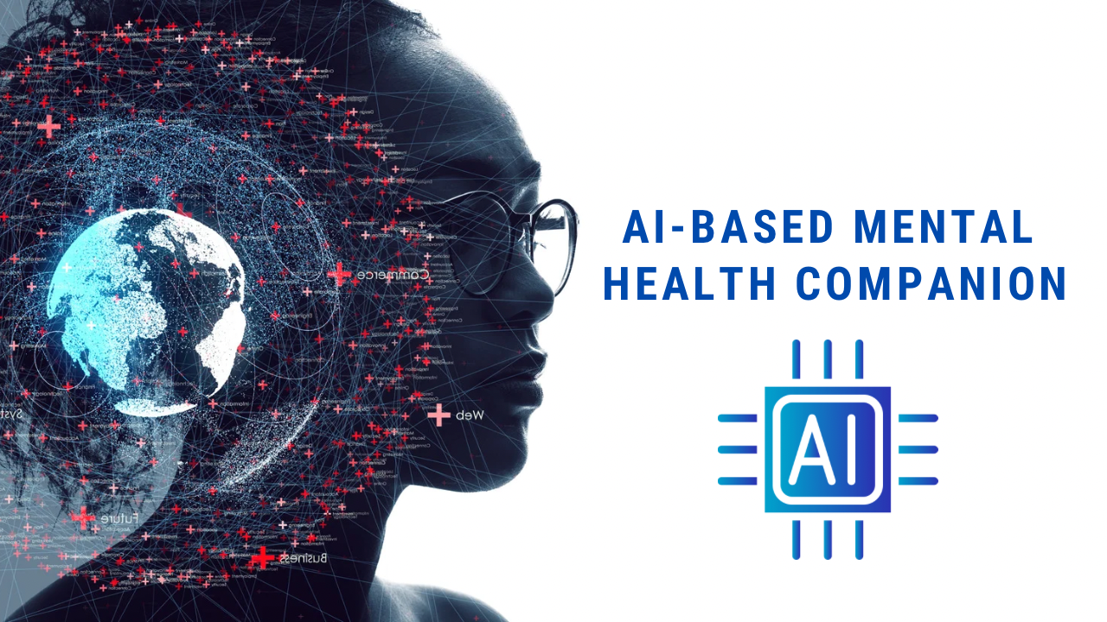
Thank You..!

